Slide 1


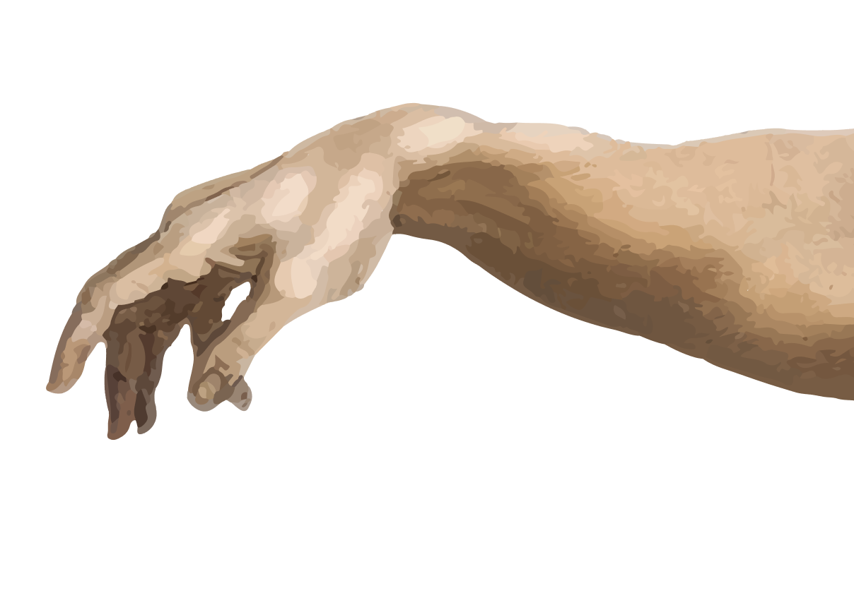

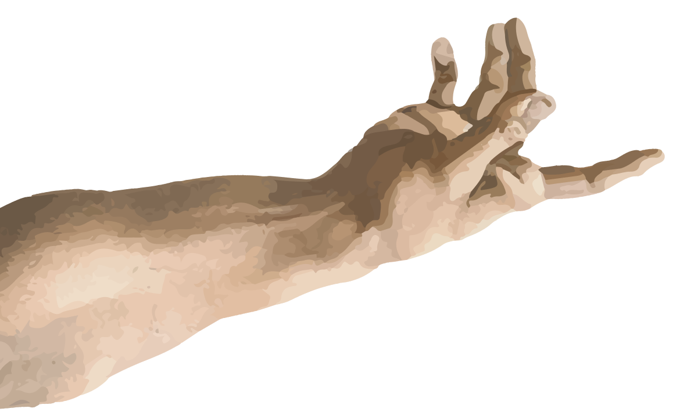
Presents

Slide 2


BASIC DETAILS
Project Name: LearnAble
Track Chosen: Track 1_Innovate For Impact
Team Name: HackHERS
Names of Members: Dhiya Sampath Kumar, Shubhi Jain, Hansika Matli, Pari Khandal

Slide 3

ABOUT THE PROJECT
LearnAble is a web platform designed to make education more accessible and engaging for children with special needs or disabilities. The project aims to provide easy-to-use, interactive learning resources for children with visual impairments, hearing impairments, autism and learning disabilities.

Slide 4
SCOPE OF PROJECT
It offers disability- friendly, customized learning features for students in classes 1–5 across English, Maths, Science.
Providing an inclusive, child-friendly interface with clear navigation, accessible fonts, and vibrant visuals.
Supporting multiple modes of interaction, such as voice feedback and simple text input to accommodate different needs.
t input, to accommodate different needs.
Creating a modular system where teachers and parents can track progress, assign activities, and encourage learning through badges and points.

Slide 5

TIMELINE OF PROJECT
Review 1 : Completion of the basic idea and basic structure of the website.
Review 2: Completion of the figma slides
Review 3: Uploading the content and integrating figma slides.
Review 4: Final completion of the website.

Slide 6
FUTURE SCOPE
Educational Equality: Breaks barriers so children with disabilities can learn alongside their peers.
Empowerment: Builds independence, self-confidence, and lifelong learning habits in children.
Global Reach: A scalable model that can be adopted by schools, NGOs, and governments worldwide.
LearnAble has the potential to become a universal platform for inclusive education, improving opportunities for millions of children with diverse learning needs.

Slide 7
TECH STACK
, Java Script, CSS, HTML, GitHub, Figma, Github Copilot

Slide 8

ANY LINKS
Figma Link : https://www.figma.com/site/dbba682claBKkFq0GNEpRp/Untitled?node-id=0-1&t=Ex4vwxGzQwStoy0r-1
GitHUB Link: https://github.com/dhiyasampathkumar2025-eng/HackHERS-LearnABLE.git

